Slide 1

[Business optimization in predicting customer churn : a machine learning approach]
[ANN Team]

Slide 2


Slide 3
OUTLINE
01
05
02
03
04
About us
Background
EDA
Data Pre-Processing
06
07
08
Churn Predict
Survival Analysis
RFM Segmentation
Summary & Recommendation

Slide 4





ANN TEAM
ANALYTICS : DIGITAL ECONOMI
Natalia Dinda S.P | Team
Nur Amilah | Team
TEACHER
DATA ANALYST
Archie Citra Muhammad | Team Lead
FREELANCER DATA ANALYST
TSDN|2022

Slide 5
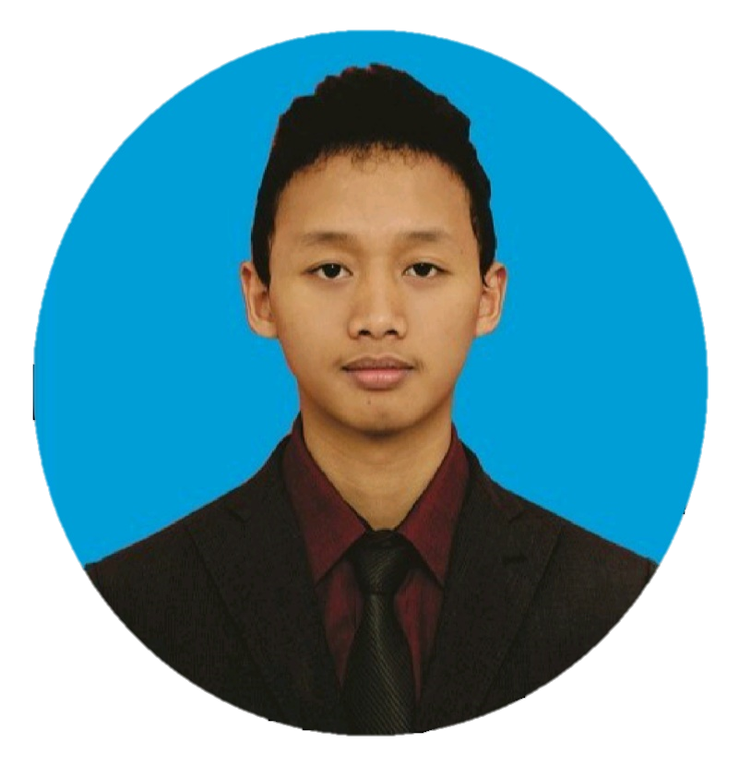
Archie Citra Muhammad | archiecm09@gmail.com
TTL : Sragen, 22 Sept 1994
No. Hp : 08112165945
Address : Sragen Tengah, Sragen , Jawa
Tengah
Social Media : @archiecm

Slide 6

Nur Amilah| nuramilahnuramilah@gmail.com
TTL : Tangerang, 16 May 2001
No. Hp : 08159887509
Address : Kp. Pagedangan, Kab. Tangerang,
Banten.
Social Media : @nuramilah_16

Slide 7

Natalia Dinda Sartika Putri | nata.dsptr@gmail.com
TTL : Tangerang, 09 June 2000
No. Hp : 085771768020
Address : Jl. Raya Mauk No.45, Jatiwaringin, Tangerang
Regency, Banten.
Social Media : @nata.dsptr_

Slide 8

FOREWORD
Digital Economy?
(Brynjolfsson & McAfee, 2014)
Business Optimization?
Machine Learning?
(Apte, 2010)
(Al-Sahaf et al., 2019)
Customer Churn?
Cashback Amount?
(Masarifoglu & Buyuklu, 2019)
(Pinem et al., 2020)

Slide 9



PROBLEM STATEMENT
Churn
Objective
16.8%
Form a machine learning model with the smallest false negative, identify predictors/factors that influence churn rate and lost opportunity customer churn, and predict customers who have the potential to churn with machine learning models. As well as providing insights & recommendations to identify predictors/factors that influence the churn rate and tenure.
China Internet Network Information Center (CNNIC)
The E-commerce customer churn rate is up to 80% compared with traditional business customer management (Wu & Meng, 2016)
Goals
Predict customer churn rate and provide recommendations to the business team so the company can implement a customer retention strategy.
Business Metrics
Lost Opportunity

Slide 10
Exploratory Data Analysis
(EDA)
Using Correlation Matrix, Bivariate and Multivariate

Slide 11
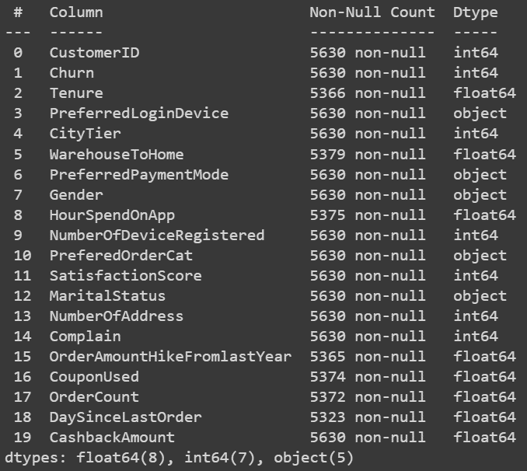



DATA OVERVIEW
Target Variable :
Churn (Classification Model)
Tenure (Regression Model)
Dataset Information?
(20 kolom dan 5630 baris, 19 variabel input, 2 var.target)
Dtype (Data Type)
Source : https://www.kaggle.com/ankitverma2010/ecommerce-customer-churn-analysis-and-prediction

Slide 12
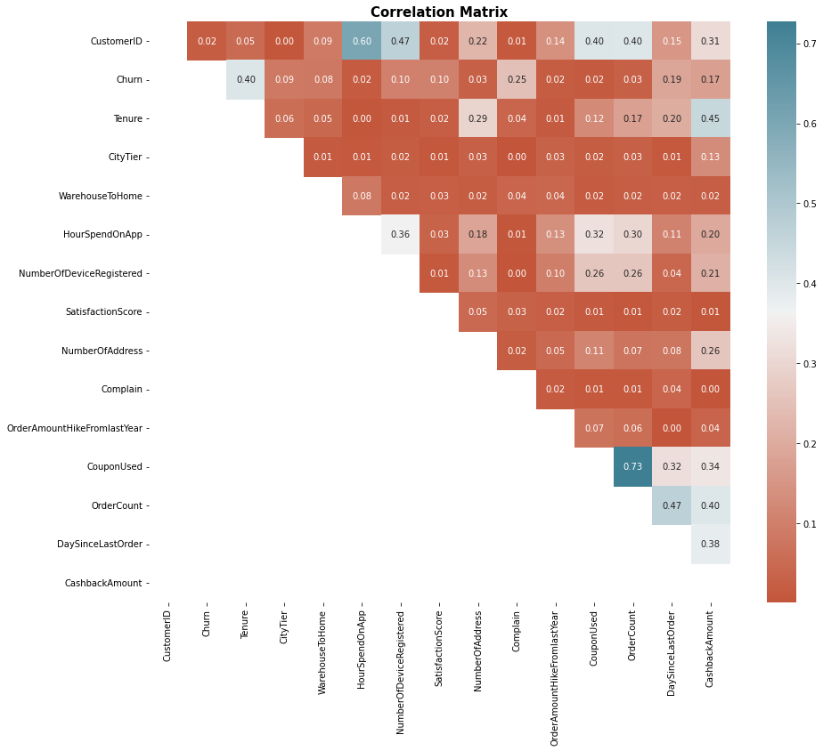
EXPLORATORY DATA ANALYSIS
Column | Correlation_ratio
Tenure | 0.40
Complain | 0.25
Cashbackamount | 0.17
Daysincelastorder | 0.19
Numberofdeviceregistered | 0.10
Satisfactionscore | 0.10
Citytier | 0.09
Warehousetohome | 0.08
Numberofaddress | 0.03
Ordercount | 0.03
Hourspendonapp | 0.02
Couponused | 0.02
Orderamounthikefromlastyear | 0.02

Slide 13
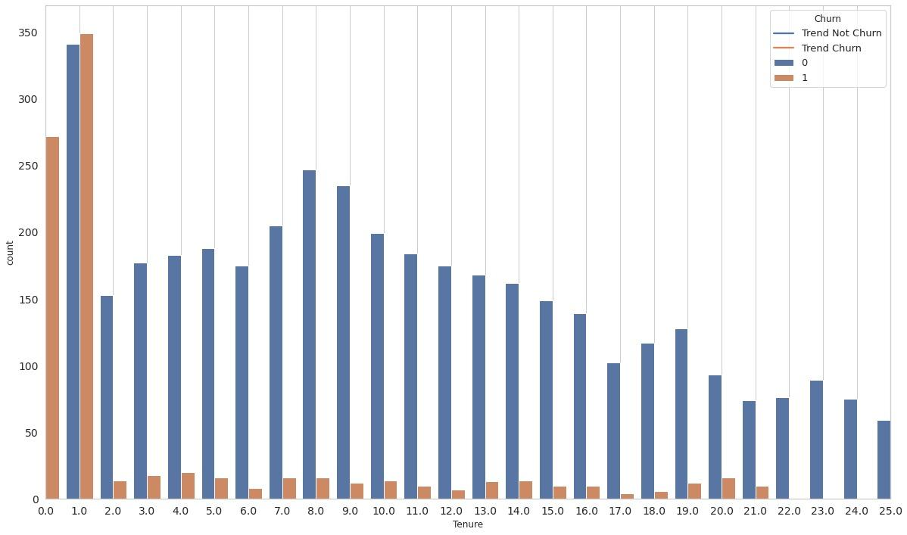
INSIGHTS
(Churn and Not Churn)
The longer tenure, the lower number of churns. And not churn has a steeper trend compared to Churn.

Slide 14
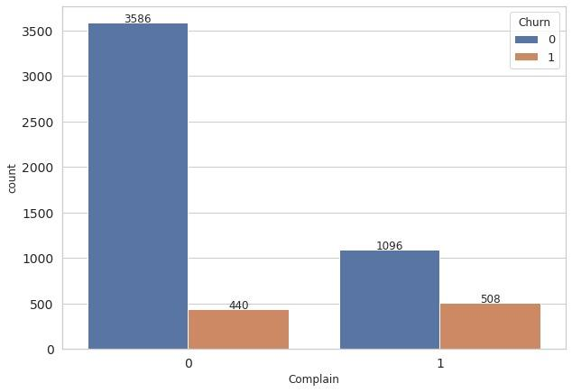
INSIGHTS
(Comparison Complain to Churn and Not Churn)
1. Customers with the highest churn of 9.0% are on customer complaints.
2. Customers with the lowest churn of 7.8% are non-complaining customers.
The more customer complaints increase, the higher the churn rate.

Slide 15
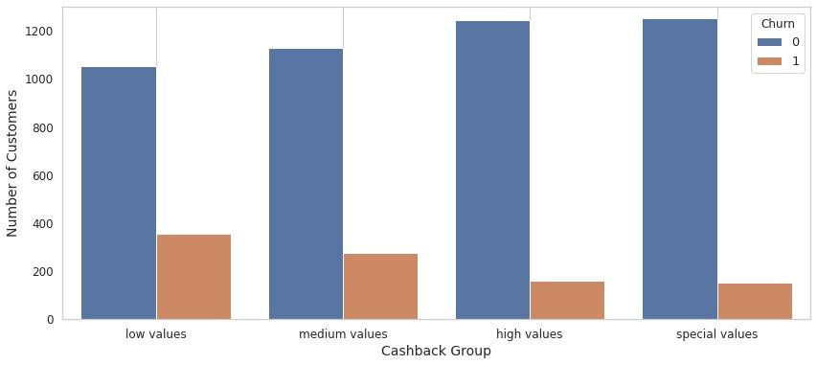
INSIGHTS
(Distribution of Cashback Customers)
Increase Cashback Amount has trend Positive in Not Churn On the contrary Increase Cashback Amount has trend Negative in Churn

Slide 16
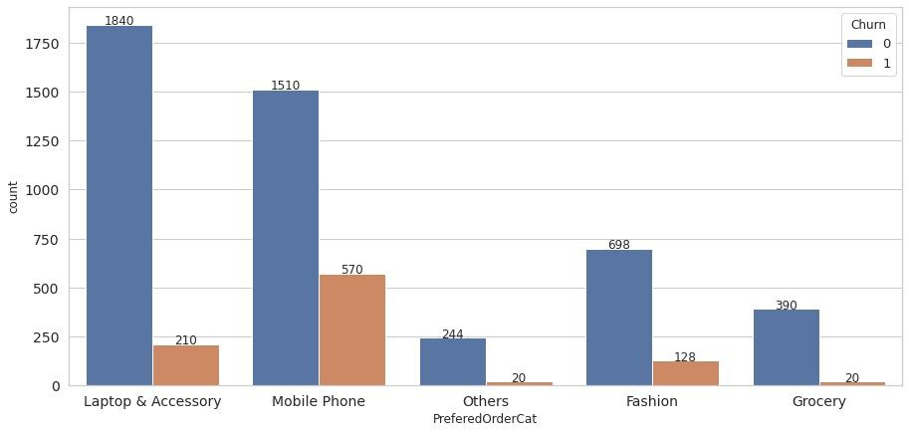
INSIGHTS
(Prefered Order Categories Customer)
Customer who ordered Laptop and Accessory has a significant number of Not Churn compared same order category with Churn.

Slide 17
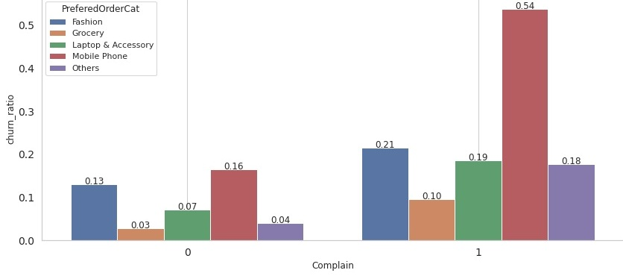
INSIGHTS
(Distribution of Complain & Order Categories vs Ratio Churn)
Customers with complaints have a ratio churn increase in all order categories.

Slide 18
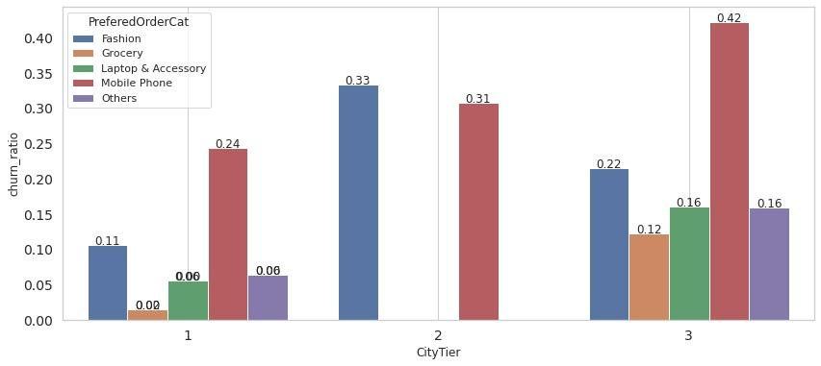
INSIGHTS
(Distribution of Complain & Order Categories vs Ratio Churn)
More City Tier increase, more ratio churn increase in Fashion and Mobile Phones

Slide 19
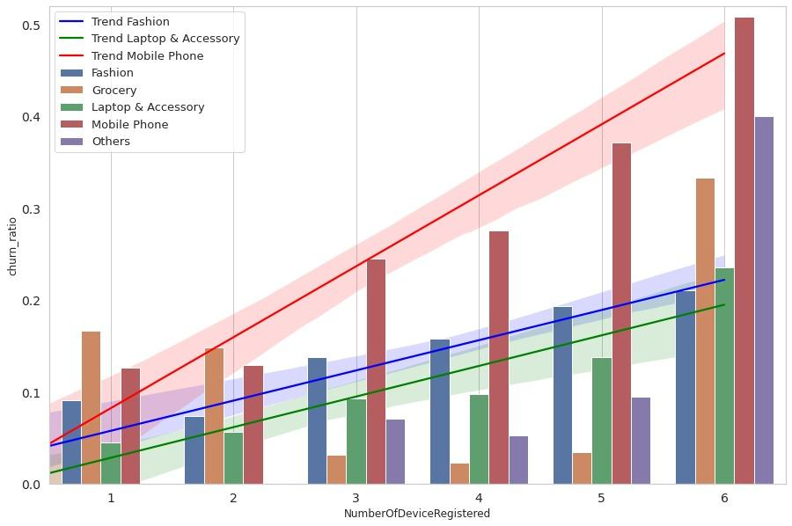
INSIGHTS
(Distribution of Complain & Order Categories vs Ratio Churn)
More Number Of Device Registered increased and more ratio churn increased in Fashion, laptops & accessories, and Mobile Phones.
“

Slide 20
INSIGHTS
(External Data)
85% of customer churn because of poor service that could have been prevented.
82% of customers have stopped doing business with e-commerce because of bad customer service.
Source : https://www.slideshare.net/ekolsky/cx-for-executives
Source : https://www.zendesk.com/blog/whycompanies-should-invest-in-the-customer-experience/
67% of customer churn could be avoided if resolved the customer’s issue during their first interaction.
Source : https://www.getfeedback.com/resources/cx/40-stats-churn-customersatisfaction/#:~:text=67%25%20of%20customer%20churn%20could,(Kolsky)

Slide 21
Data Pre-Processing
Data Cleaning
Feature Encoding
Transforming
Feature Encoding
Check Irrelevant Data
Check Missing Data
Check Duplicate
Check Outlier
One Hot Encoder
Simple Imputer
Iterative Imputer
80 : 20
Train : Test
Robust Scaler
Standard Scaler

Slide 22
Predict Churn
Selection Models & Cross Validation, Handling Imbalance,
Hyperparameter Tuning, Feature Importance with SHAP

Slide 23
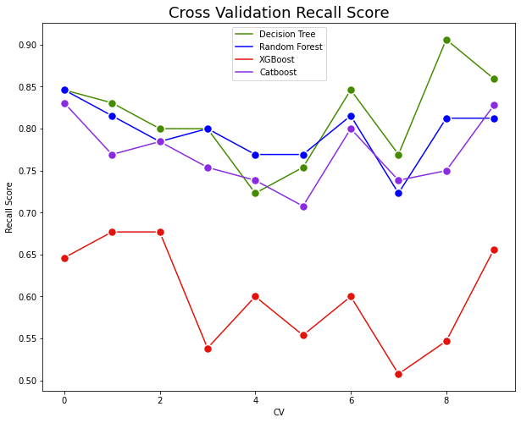
Model Selection & Cross-Validation
Models | Recall | Cross Validation | Standar Deviasi
Decision Tree | 0.863095 | 0.803951 | 0.038707
Catboost | 0.809524 | 0.780246 | 0.047106
Random Forest | 0.797619 | 0.760799 | 0.048173
Xgboost | 0.553571 | 0.609570 | 0.066454
Logistic Regression | 0.476190 | 0.530575 | 0.051384
NB : Due to an imbalance dataset

Slide 24
Handling Imbalance Target
NB : Due to imbalance dataset
CatBoost
 | Without | Undersampling | Oversampling
Train Recall | 0.953360 | 0.996913 | 0.999826
Test Recall | 0.784038 | 0.928990 | 0.915144
DECISION TREE
 | Without | Undersampling | Oversampling
Train Recall | 1.000000 | 1.000000 | 1.000000
Test Recall | 0.836538 | 0.881202 | 0.819519
Catboost have best fit in undersampling and oversampling. But we choose undersampling because it has gap (train-test) smaller than other.

Slide 25
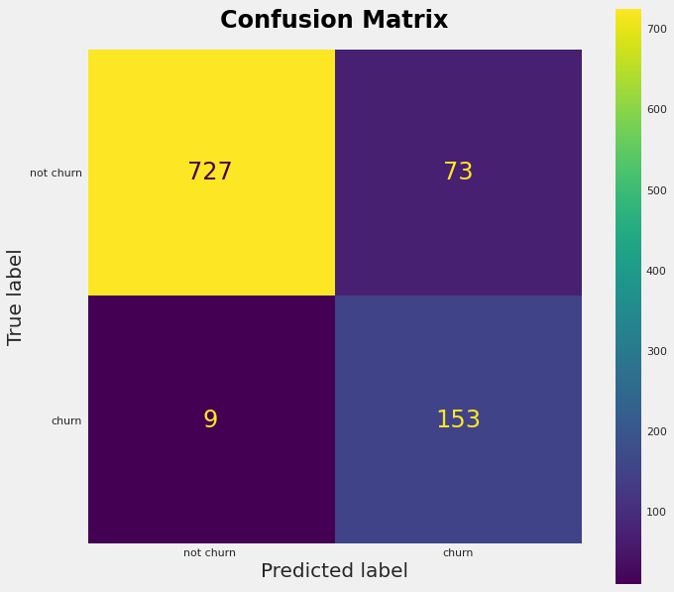
CatBoost Classifier + Undersampling
classification_report before tuning:
precision recall f1-score support
0 0.99 0.91 0.95 800
1 0.68 0.94 0.79 162
accuracy 0.91 962
macro avg 0.83 0.93 0.87 962
weighted avg 0.94 0.91 0.92 962
Recall 0.9444444444444444
Recall ; How many customers did we correctly predict to take an interest with our product compared to all customers which are truly churn? 94%

Slide 26

CatBoost Classifier + Undersampling + Tuning
n_estimators = [1000]
learning_rate = [float(x) for x in np.linspace(0.001, 0.1, 20)]
classification_report after tuning:
precision recall f1-score support
0 1.00 0.91 0.95 800
1 0.70 0.98 0.82 162
accuracy 0.93 962
macro avg 0.85 0.95 0.88 962
weighted avg 0.95 0.93 0.93 962
Recall 0.9814814814814815
Recall 98%

Slide 27

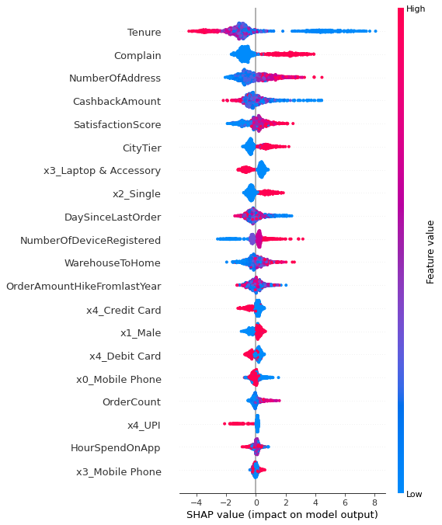
Feature Importance with SHAP
Feature Importance will be exploratory
Value that generates churn
Value that generates retention
https://medium.com/dataman-in-ai/explain-your-model-with-the-shap-values-bc36aac4de3d

Slide 28
Survival Analyst
Using Kaplan-Meier (KM) and COx Proportional Hazard (CPH) Model

Slide 29
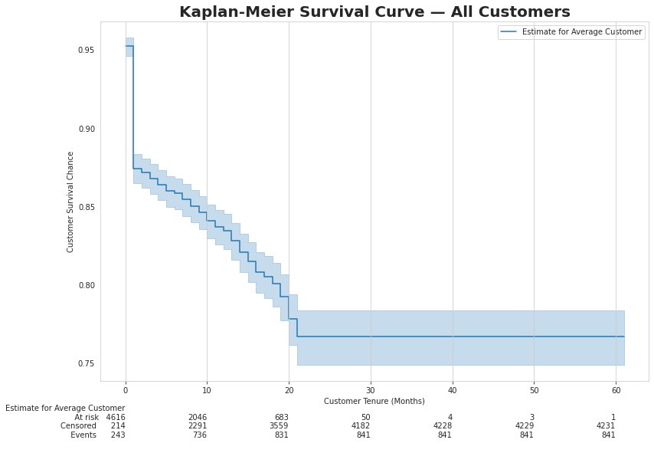
Kaplan-Meier(KM) Survival Curve
20
At risk : 683 customer not churn (13%)
20
Censored : 3559 customer will be churn (70%)
20
Events : 831 customer churn (17%)
https://towardsdatascience.com/how-to-not-predict-and-prevent-customer-churn-1097c0a1ef3b

Slide 30
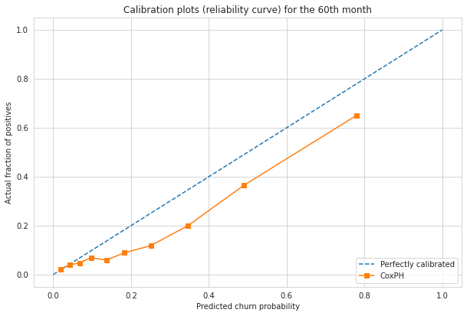

Cox Proportional Hazard (CPH) Model
Model | lifelines.CoxPHFitter
Duration col | 'Tenure'
Event col | 'Churn'
Baseline estimation | breslow
Number of observations | 5073
Number of events observed | 841
Partial log-likelihood | -6296.226
Time fit was run | 2022-11-19 08:47:34 UTC
Model | base model
AUC-ROC logistic regression.
Concordance | 0.829
Partial AIC | 12640.452
log-likelihood ratio test | 1223.310 on 24 df
-log2(p) of ll-ratio test | 805.834
The Brier Score of our CPH Model is 0.11 at the end of 60 months
Predictions from the model up to 60 months are still close to true values.
https://towardsdatascience.com/how-to-not-predict-and-prevent-customer-churn-1097c0a1ef3b

Slide 31
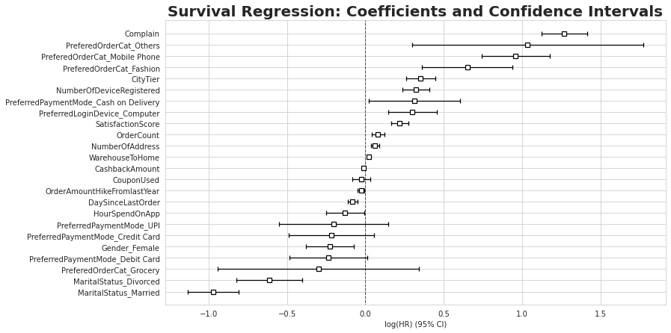
CPH Model Visualization
Feature that generates churn
Feature that generates retention

Slide 32
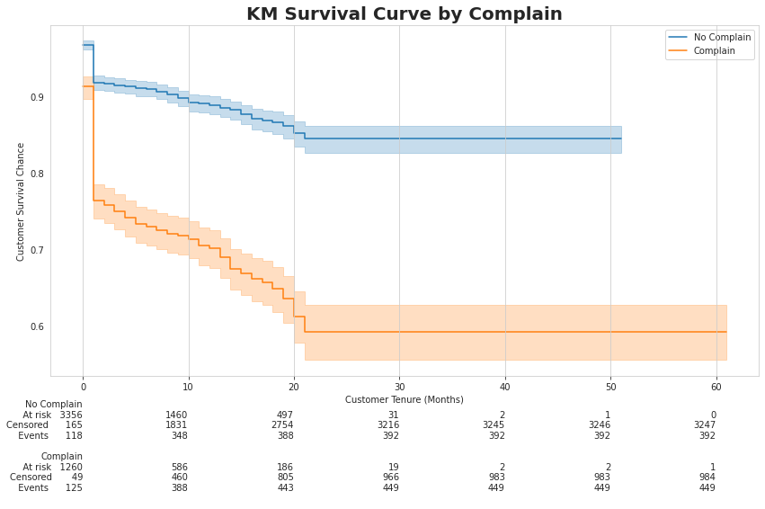
Churn Prediction and Prevention
Customer Survival Chance
No complaint have 89%
Complaint have 68%
15%
75%
15%
10%
56%
29%

Slide 33
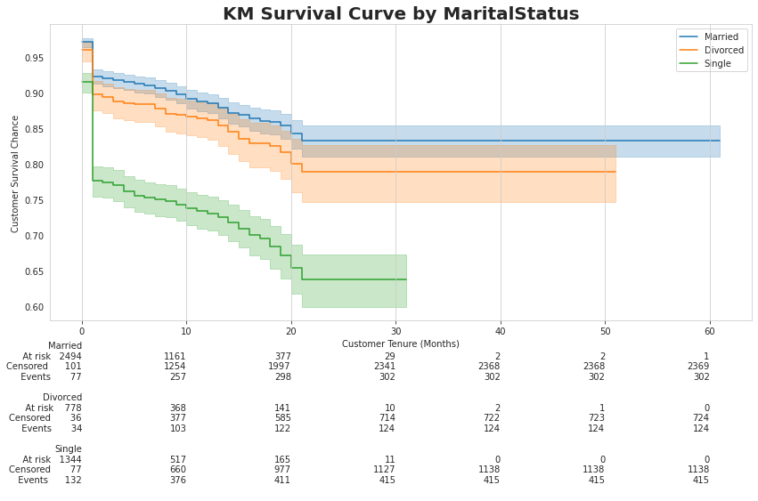
Churn Prediction and Prevention
Customer Survival chance in Marital Status
88% of Married
85% of Divorced
73% of Single
15%
75%
14%
11%
63%
26%

Slide 34
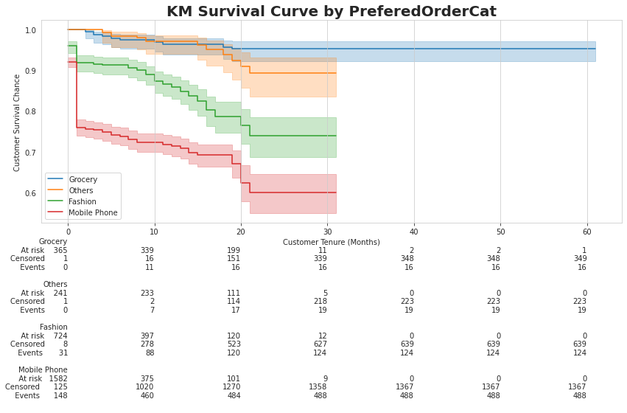
Churn Prediction and Prevention
Customer Survival chance in Prefered Order Category
95% of Grocery
92% of Others
83% of Fashion
54%
73% of Mobile Phone
41%
5%
6%
68%
26%

Slide 35
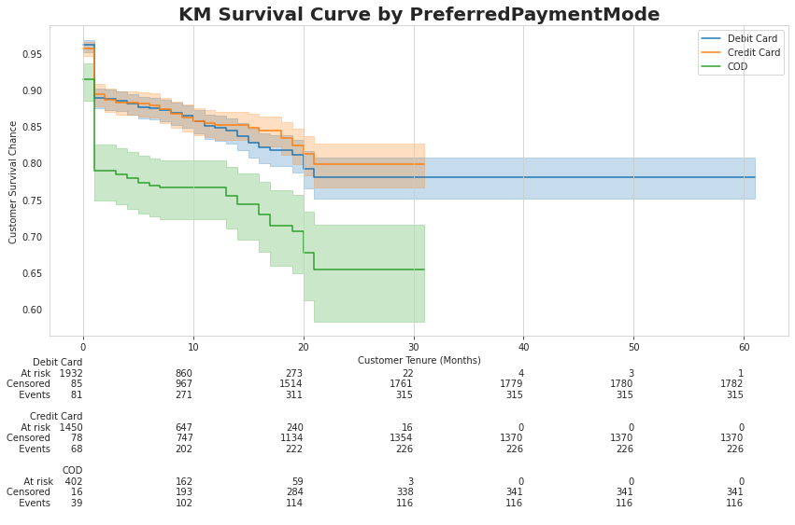
Churn Prediction and Prevention
Customer Survival chance in Prefered Payment Mode
84% of Debit Card
86% of Credit Card
74% of COD
15%
71%
13%
14%
62%
25%

Slide 36


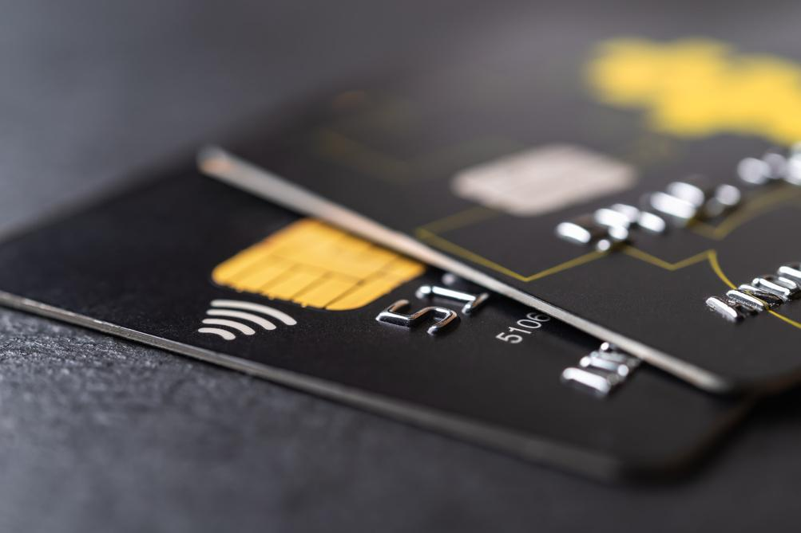

Recommendation Business
1
2
Complain
Marital Status
Create Customer Experience, can Fast Handling Complain, ask for customer feedback at regular intervals
Targeting campaigns, products and services fit with status Married or Family Package
Preferred Payment Mode
Preferred Order Cat
Encourage customers to set up payments either through a debit card or credit card
Encourage customers to preferred order category grocery
3
4
https://www.zendesk.com/blog/why-companies-should-invest-in-the-customer-experience/

Slide 37

predict_survival_function
Censored Customer with Tenure 60 months
https://lifelines.readthedocs.io/en/latest/fitters/regression/CoxPHFitter.html#lifelines.fitters.coxph_fitter.SemiParametricPHFitter.predict_survival_function
Calculate Expected Loss Table
CustomerID | Cashback Amount | Exp_Churn_Month | Exp_Loss | Baseline
50046 | 130.58 | 11.00 | 1,436.38 | 11.00
50048 | 120.88 | 19.00 | 2,296.72 | 19.00
50177 | 112.00 | 15.00 | 1,680.00 | 15.00
50194 | 124.78 | 14.00 | 1,746.92 | 14.00
50230 | 147.36 | 14.00 | 2,063.04 | 14.00
CustomerID 50046 :
Churn at month 11
Expected Loss of $14,363
Estimated Revenue Uplift Table
OrderCat_Grocery_Uplift | PaymentMode_Credit Card_Uplift | PaymentMode_Debit Card_Uplift
16.00 | 14.00 | 15.00
20.00 | 19.00 | 20.00
20.00 | 15.00 | 20.00
19.00 | 17.00 | 14.00
17.00 | 16.00 | 17.00
Estimated Revenue Uplift
Order Category Grocery $ 160
Payment Debit Card $ 150
Payment Credit Card $ 140

Slide 38
Segmentation of Customer
Using RFM Segmentation, K-Means, and Gaussian

Slide 39
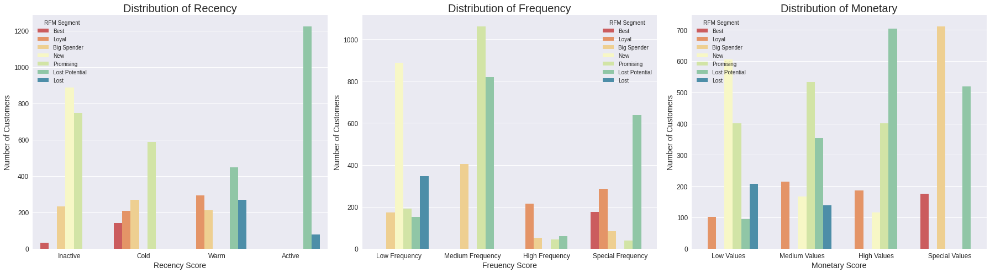

RFM Segmentation
Column DaySinceLastOrder as Recency
Column OrderCount as Frequency
Column CashbackAmount as Monetary
4
Segment RFM Score

Slide 40
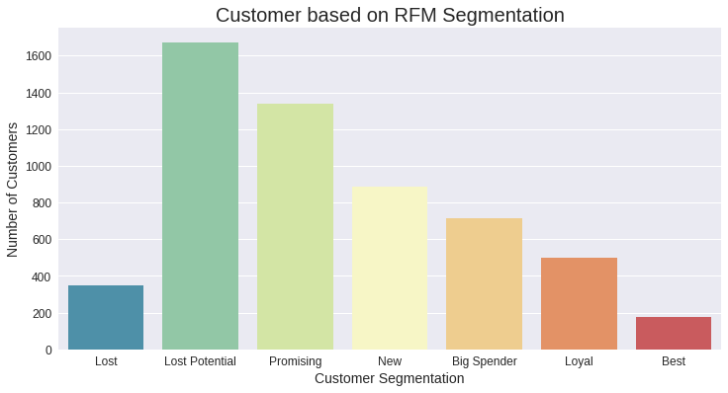

RFM Segmentation
The RFM segment is based on scores from the Recency, Frequency, and Monetary distribution
'Best', 'Loyal', 'Big Spender', 'New', 'Promising', 'Lost Potential', 'Lost'

Slide 41
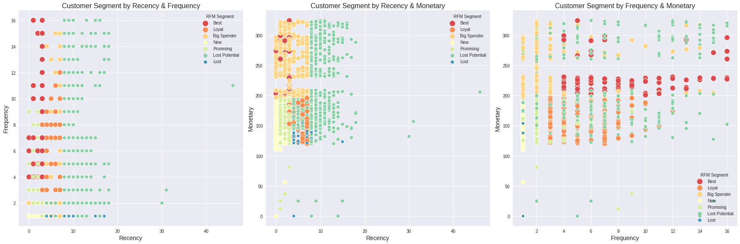
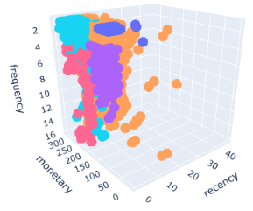
RFM Segmentation

Slide 42

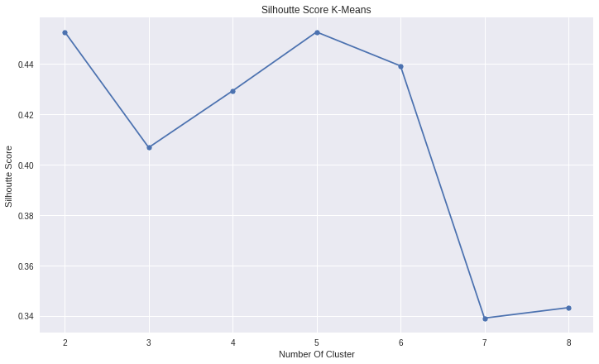
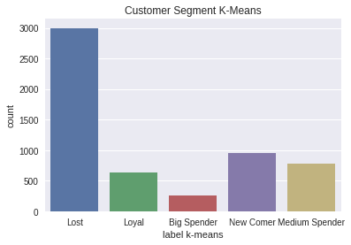
K-Means
The best Silhouette Score
5
Using Clusters

Slide 43
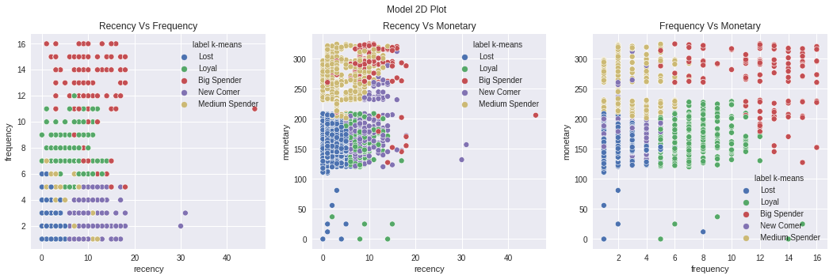
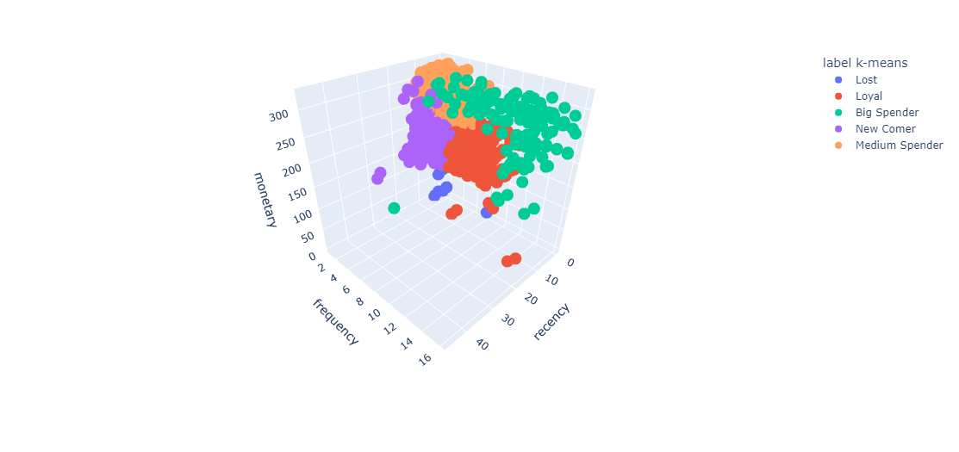
K-Means

Slide 44
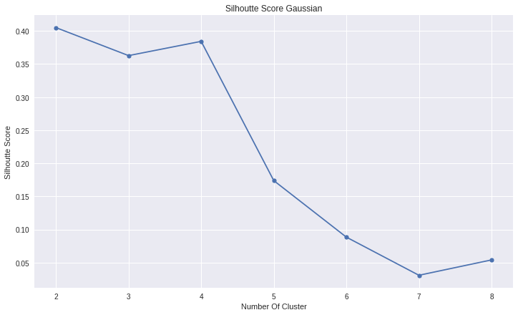
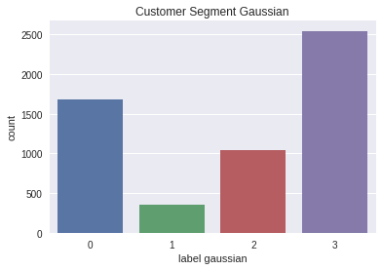
Gaussian
The best Silhouette Score
4
Using Clusters

Slide 45
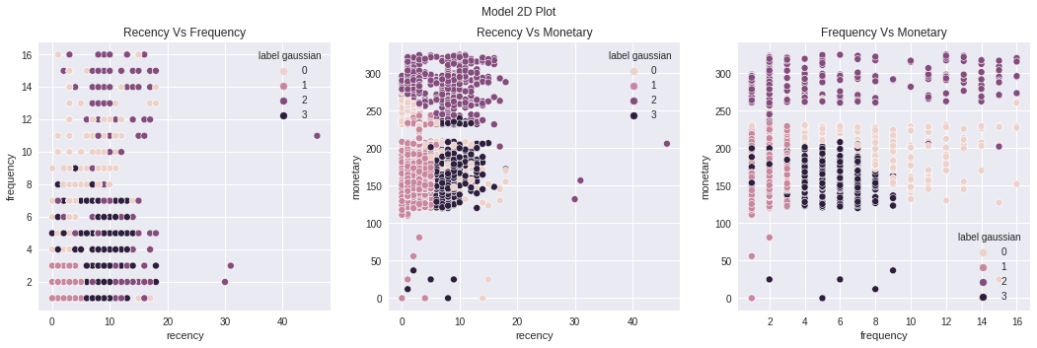
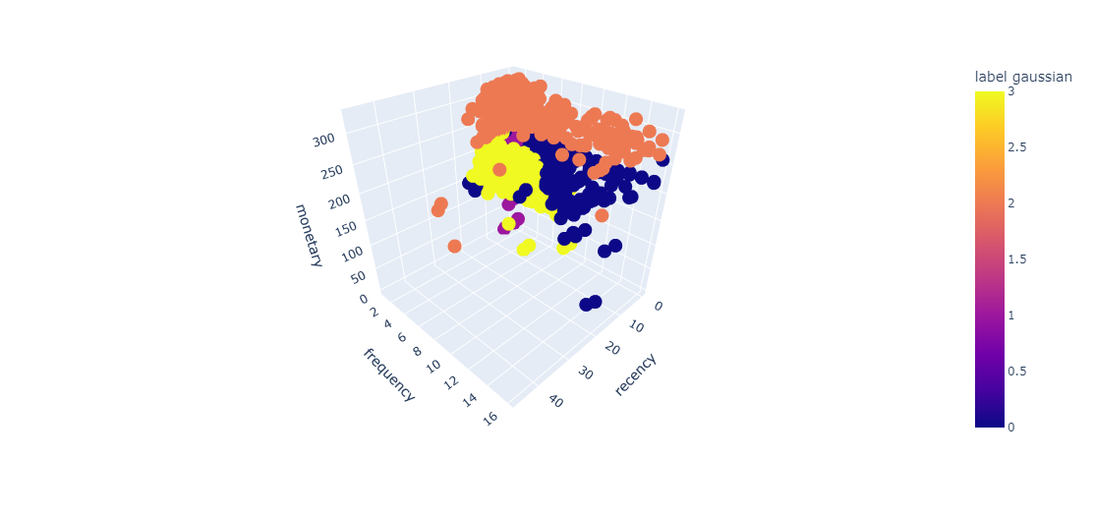
Gaussian

Slide 46
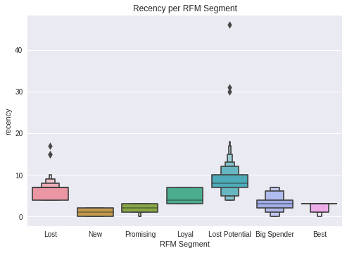
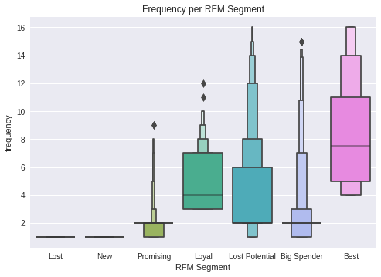
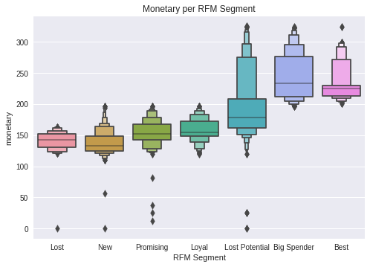
Summary RFM Segmentation
“
The RFM Segmentation model is a model that has the highest interpretation compared to other models & this model is made with *domain knowledge* that we have
”
RFM Segment | Mean Recency | Mean freq | Mean monetary | Most payment type | most product buy
Best | 2.625000 | 8.357955 | 230.968920 | Debit Card | Fashion
Loyal | 4.846307 | 4.842315 | 158.280918 | Debit Card | Laptop & Acc
Big Spender | 3.200843 | 2.567416 | 244.787219 | Debit Card | Fashion
New | 1.010135 | 1.000000 | 138.116137 | Debit Card | Mobile Phone
Promising | 2.079341 | 2.006737 | 153.928451 | Debit Card | Mobile Phone
Lost Potential | 8.461999 | 4.210054 | 195.301556 | Debit Card | Laptop & Acc
Lost | 6.132948 | 1.000000 | 141.281647 | Credit Card | Laptop & Acc

Slide 47
R F M S E G M E N T
S T R A T E G Y
Best
Customers who made transactions recently made frequent transactions and had the highest total transactions.
Loyalty program/reward points, new product recommendations, and exclusive item offers (Cross / Up Selling Strategy).
Loyal
Customers who make the most frequent transactions.
Loyalty program/reward point and exclusive item offers (Cross / Up Selling Strategy).
Big Spender
Customers who have the highest total transactions.
Exclusive product recommendations, partnership/membership (B2B) offers, and wholesale price purchase offers (Cross / Up Selling Strategy).
New
Customers who recently made a transaction and only made one transaction.
Welcome email for relationship building, loyalty program/reward point offers, and discount vouchers (Cross / Up Selling Strategy).
Promising
Customers who recently made transactions, as well as the frequency and total transactions above the average of other customers.
Regular limited offers, discount vouchers and cashback via e-mail (Retention Strategy).
Lost Potential
Customers who have not made transactions for a long time, but the frequency and total transactions are above the average of other customers.
Regular limited offers, discount vouchers and cashback via e-mail (Retention & Reactivate Strategies)
Lost
Customers who haven't made transactions for a long time only made one transaction, and the total number of transactions was small.
Campaign via e-mail and ask for feedback. (Reactivation Strategy)
Summary RFM
Segmentation

Slide 48




Customer Churn Treatment
Ask for customer feedback at regular intervals & Fast Handling Complain
YES
YES
Complain?
YES
Tenure < 2
Identification customers based on RFM Segmentation
NO
Predict Churn
NO
Proactive communication based on RFM Segmentation
Identification customers based on RFM Segmentation
Preferred Order Category Groceries
Payment Credit Card or Debit Card
YES
NO
Survival Analysis
is censored?
Regular communication based on RFM Segmentation
Source : https://whiplash.com/blog/reduce-customer-churn/
NO

Slide 49
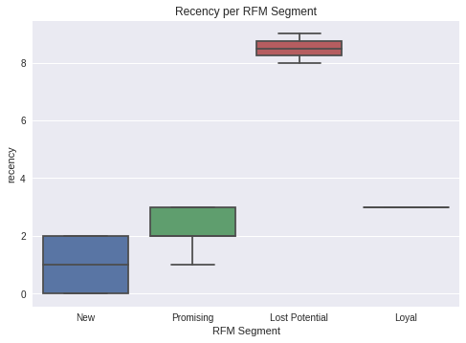
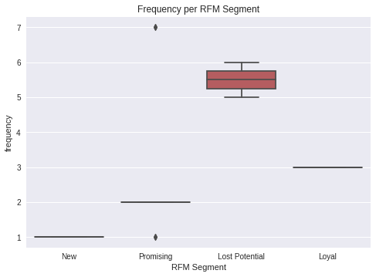
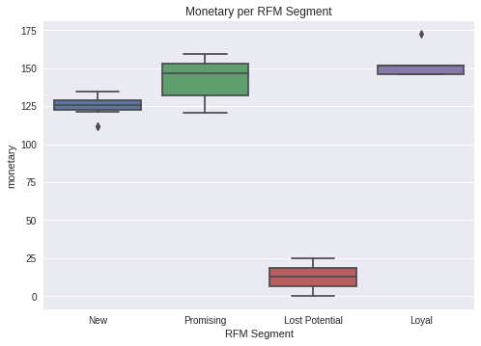
Censored Customer Treatment
RFM Segment | RFM Segment Score | n cust | mean recency | mean freq | mean monetary | most payment type | avg review score | most product buy
Loyal | 6 | 5 | 3.00000 | 3.000 | 153.3800 | Cash on Delivery | 3.80000 | Mobile Phone
New | 4 | 19 | 1.10526 | 1.000 | 125.2715 | Credit Card | 3.89473 | Mobile Phone
Promising | 3 | 23 | 2.30434 | 2.347 | 141.9330 | Cash on Delivery | 3.69565 | Mobile Phone
Lost Potential | 2 | 2 | 8.50000 | 5.500 | 12.50000 | E wallet | 2.00000 | Mobile Phone

Slide 50




Recommendation Business
1
2
Loyal Customer
New Customer
Loyalty program/reward point and exclusive item offers (Cross / Up Selling Strategy)
“Welcome email” to build relationships, offer loyalty programs/reward points, and discount vouchers (Cross / Up Selling Strategy).
Promising Customer
Lost Potential
Regular limited offers, discount vouchers and cashback via email (Retention Strategy).
Regular limited offers, discount vouchers, and cashback via e-mail (Retention & Reactivate Strategies).
3
4

Slide 51
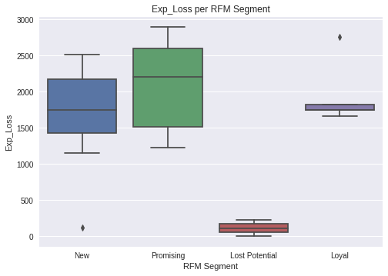
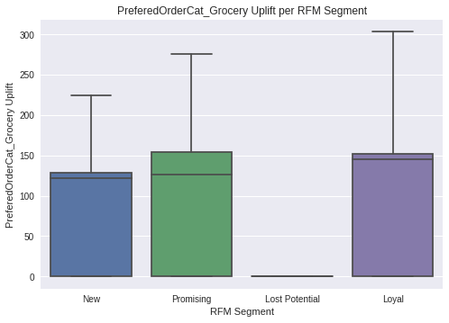
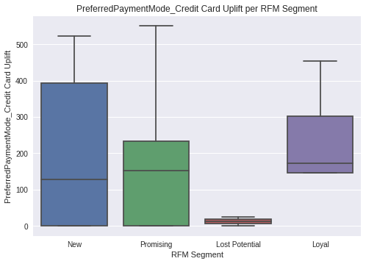
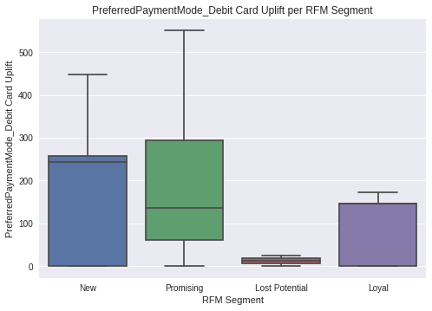
Estimated Loss & Revenue Uplift
RFM Segment | RFM Segment Score | n cust | sum Exp Loss | sum Grocer Uplift | sum Credit Card Uplift | sum Debit Card Uplift
Loyal | 6 | 5 | 9740.67 | 600.41 | 1221.61 | 463.76
New | 4 | 19 | 32903.0 | 1372.46 | 3987.19 | 3389.94
Promising | 3 | 23 | 48200.0 | 2271.93 | 3944.68 | 3975.56
Lost Potential | 2 | 2 | 225.00 | 0.00 | 25.00 | 25.00
Estimated Revenue Uplift :
$910,687
Order category grocery $42,448
Total Expected Loss
Payment Credit Card $91,785
Payment Debit Card $78,543

Slide 52
SUMMARY
SUMMARY
From the data visualization, it is obtained that the churn ratio has a correlation with tenure, complaints, cashback Amount, & preferred order cat.
The results of predicting churn are strongly influenced by the level of Tenure, Complaint, Number of Addresses, and cashback Amount.
The results of the Survival Analysis, the customer has the greatest survival chance in No Complain, Marital Status Married, Payment Mode Credit Card, Order Category Grocery.
RFM Segmentation results show priority customer treatment in the Loyal, New, Promising, and Lost Potential segments.
Total Expected Loss of $ 910,687
Estimated Revenue Uplift
Order category Grocery $42,448
Payment Credit Card $ 91,785
Payment Debit Card $ 78,543

Slide 53
SUMMARY
SUMMARY
From the data visualization, it is obtained that the churn ratio has a correlation with tenure, complaints, cashback Amount, & preferred order cat.
The results of predicting churn are strongly influenced by the level of Tenure, Complaint, Number of Addresses, and cashback Amount.
The results of the Survival Analysis, the customer has the greatest survival chance in No Complain, Marital Status Married, Payment Mode Credit Card, Order Category Grocery.
RFM Segmentation results show priority customer treatment in the Loyal, New, Promising, and Lost Potential segments.
Total Expected Loss of $ 910,687
Estimated Revenue Uplift
Order category Grocery $42,448
Payment Credit Card $ 91,785
Payment Debit Card $ 78,543

Slide 54
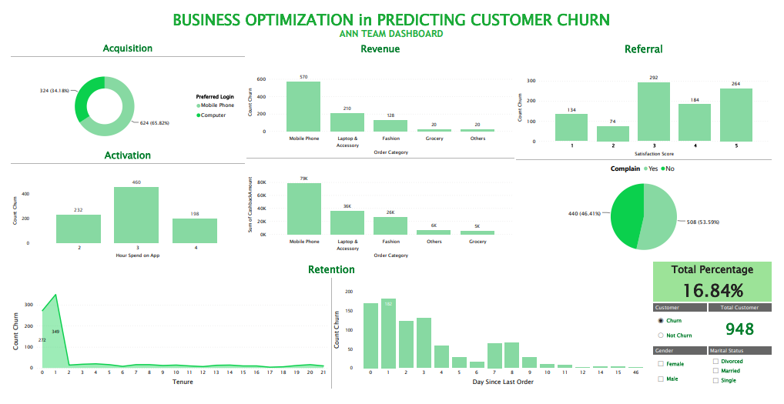
Business Analytics Dashboard
Link : https://app.powerbi.com/groups/06be1cdf-3422-46e2-b0c1-6605fed8dfe5/reports/dcf2e131-7f8b-4661-b764-d7891b4840cb/ReportSectionc04ef661493e23894037

Slide 55
Bibliography
Agrawal, A., Gans, J., & Goldfarb, A. (2018). Prediction machines: the simple economics of artificial intelligence. Harvard Business Press.
Al-Sahaf, H., Bi, Y., Chen, Q., Lensen, A., Mei, Y., Sun, Y., Tran, B., Xue, B., & Zhang, M. (2019). A survey on evolutionary machine learning. Journal of the Royal Society of New Zealand, 49(2), 205–228. https://doi.org/10.1080/03036758.2019.1609052
Apte, C. (2010). Invited Applications Paper: The Role of Machine Learning in Business Optimization. Proceedings of the 27th International Conference on Machine Learning, Haifa, Israel, 2010.
Brynjolfsson, E., & McAfee, A. (2014). The second machine age: Work, progress, and prosperity in a time of brilliant technologies. WW Norton & Company.
Masarifoglu, M., & Buyuklu, A. H. (2019). Applying Survival Analysis to Telecom Churn Data (pp. 261–275). American Journal of Theoretical and Applied Statistics.
Pinem, R. J., Afrizal, T., & Saputra, J. (2020). The Relationship of Cashback, Discount, and Voucher toward Decision to Use Digital Payment in Indonesia. Talent Development & Excellent, 12(3s), 2766–2774.
Wu, X., & Meng, S. (2016). E-commerce Customer Churn Prediction Based on. 2016 13th International Conference on Service Systems and Service Management (ICSSSM), 1–5.
https://www.kaggle.com/ankitverma2010/ecommerce-customer-churn-analysis-and-prediction

Slide 56


